Slide 1
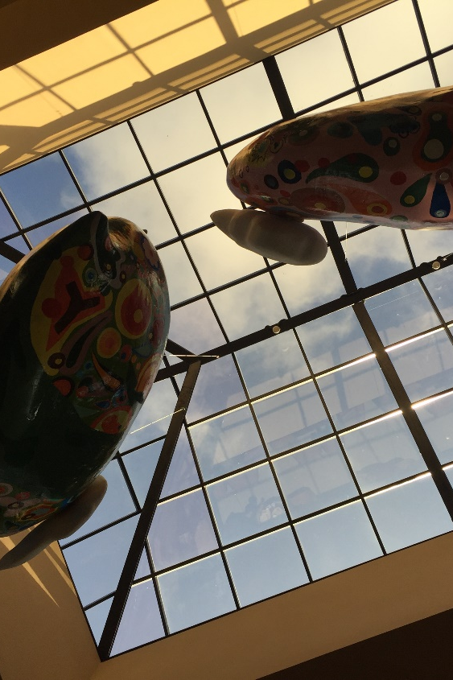
ELEPHANT FX
中文/Eng
A wonderful platform for Currency Exchange in China mainland
Reliable - 100% approved by the China’s SAFE
Secure - Order online and exchange in physical stores
Economical – The most optimal exchange rates with 0 handling charge
Convenient – The network Cover 25 airports, 32 transportation junction, and 12 entry-exit ports in the Chinese big cities
Time-saving - Order online and pick it up immediately wherever you start your journey
Worry-saving – The fixed exchange rates
Brown Café, Yilan
SHANGHAI MAIJU INFO TECHNOLOGY CO., LTD
5F, Standard Chartered Bank Building, 201 Century Avenue, Lujiazui, Shanghai
Wechat: Daxiang_FX | Email CS@fxswap.cn‍
Business Cooperation: Biz@fxswap.cn
Copyright © 2016 大象汇率（www.fxswap.cn）, All Rights Reserved

